Slide 1
Data Science with Python Career Program
Capstone Project

Slide 2
Data Science with Python Career Program
Name : Amit Kumar
Phone No. : 7881178181
Email : amitkumar209727@gmail.com

Slide 3
Data Science with Python Career Program
DATASET Name
🚘 Car Details 🚘

Slide 4
🚘 Analysis Car Details Dataset
TABLE OF CONTENTS
1. Introduction:
2. Importing the Dataset and Explanation of Features:
3. Visualization of features for better understanding:
4. Build ML Regression Models
5. CONCLUSION:

Slide 5
Discription of Data Set
⭐Introduction⭐
This data is collected from CAR DETAILS'. Following details of cars are included in the dataset:
1) Car name 2) Year 3) Selling Price 4) Kms driven 5) Fuel 6) Seller type 7) Transmission 8) Owner
I will try to understand the data, analyze it, extract reports from it, and try to understand the relationships between the different variables

Slide 6
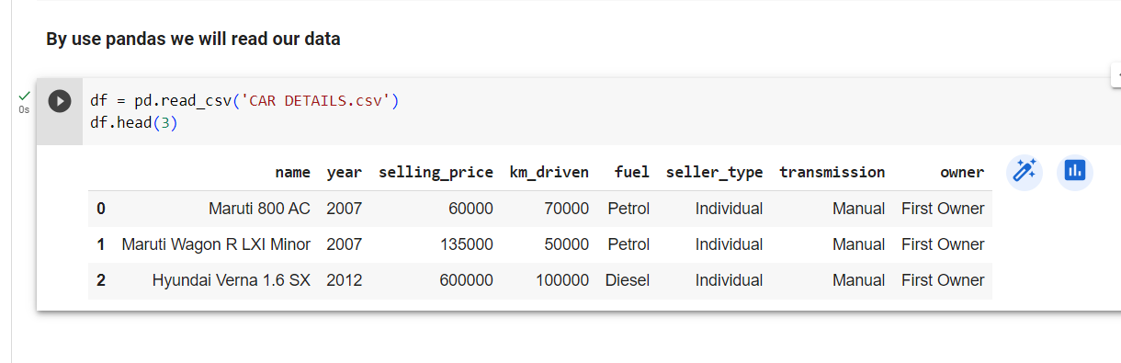
The first step, we want to know what Dataset Contains
# we want to know about data
df.head()

Slide 7
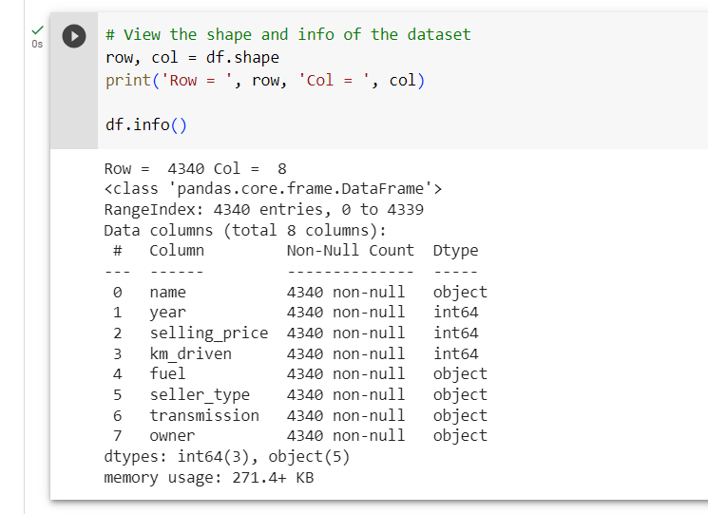
The first step, we want to know what Dataset Contains
# View the shape and info of the dataset
row, col = df.shape
print('Row = ', row, 'Col = ', col)
df.info()

Slide 8
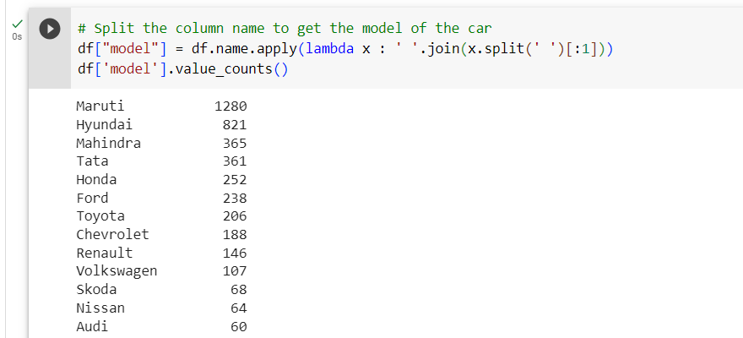
The first step, we want to know what Dataset Contains
# Split the column name to get the model of the car
df["model"] = df.name.apply(lambda x : ' '.join(x.split(' ')[:1]))
df['model'].value_counts()

Slide 9
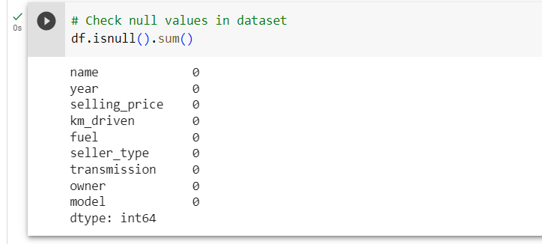
The first step, we want to know what Dataset Contains
# Check null values in dataset
df.isnull().sum()

Slide 10
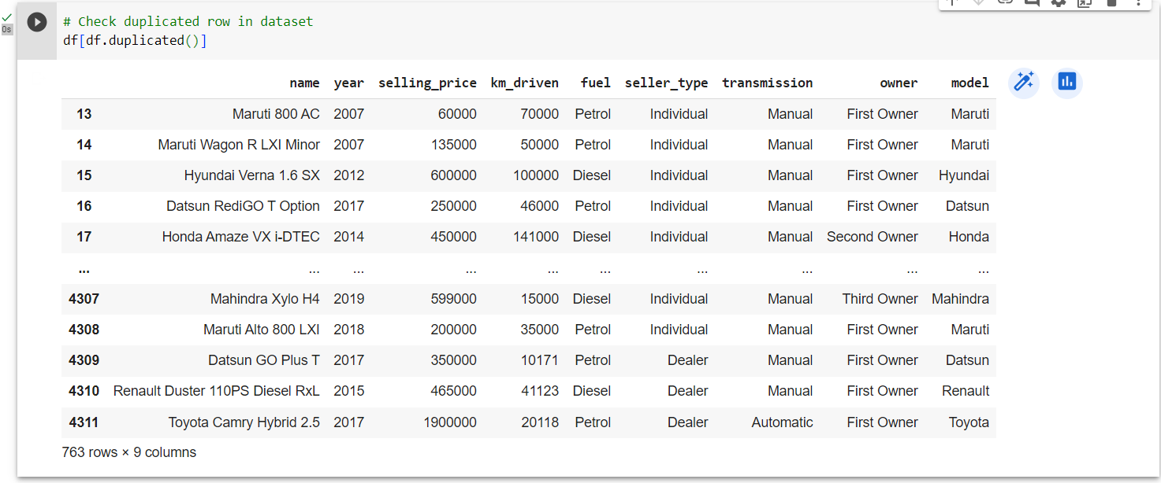
The first step, we want to know what Dataset Contains
# Check duplicated row in dataset
df[df.duplicated()]

Slide 11
The first step, we want to know what Dataset Contains
# Check duplicated row in dataset
df[df.duplicated()]

Slide 12
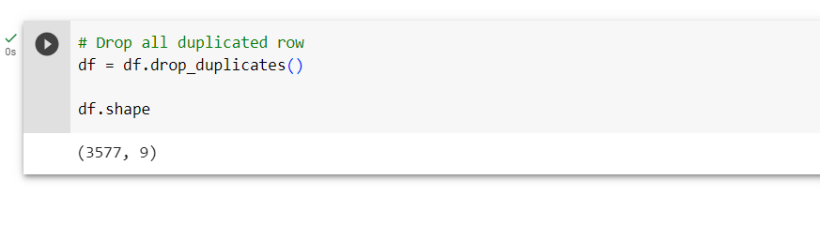
The first step, we want to know what Dataset Contains
# Drop all duplicated row
df = df.drop_duplicates()

Slide 13
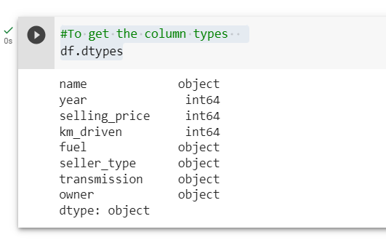
The first step, we want to know what Dataset Contains
#To get the column types
df.dtypes

Slide 14
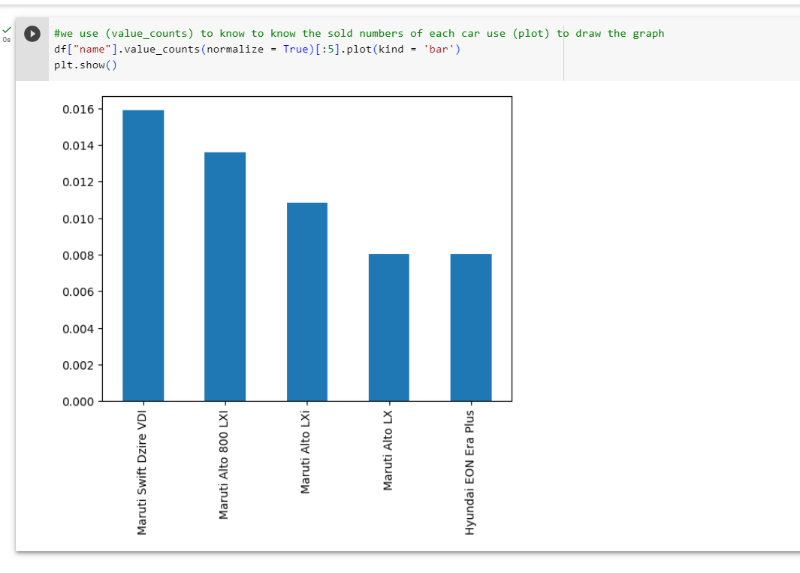
2. Importing the Dataset and Explanation of Features:
#we use (value_counts) to know to know the sold numbers of each car use (plot) to draw the graph
df["name"].value_counts(normalize = True)[:5].plot(kind = 'bar')
plt.show()

Slide 15
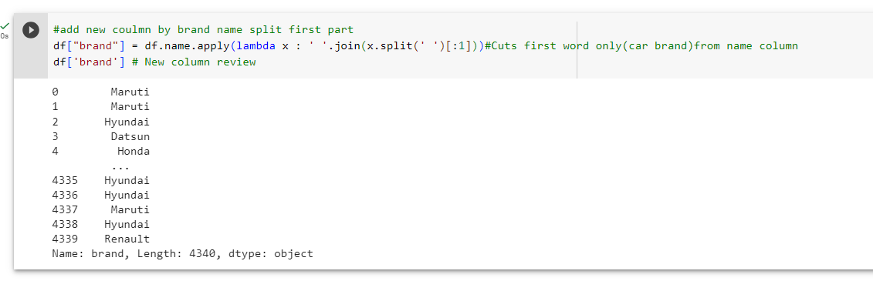
2. Importing the Dataset and Explanation of Features:
#add new coulmn by brand name split first part
df["brand"] = df.name.apply(lambda x : ' '.join(x.split(' ')[:1]))#Cuts first word only(car brand)from name column
df['brand'] # New column review

Slide 16
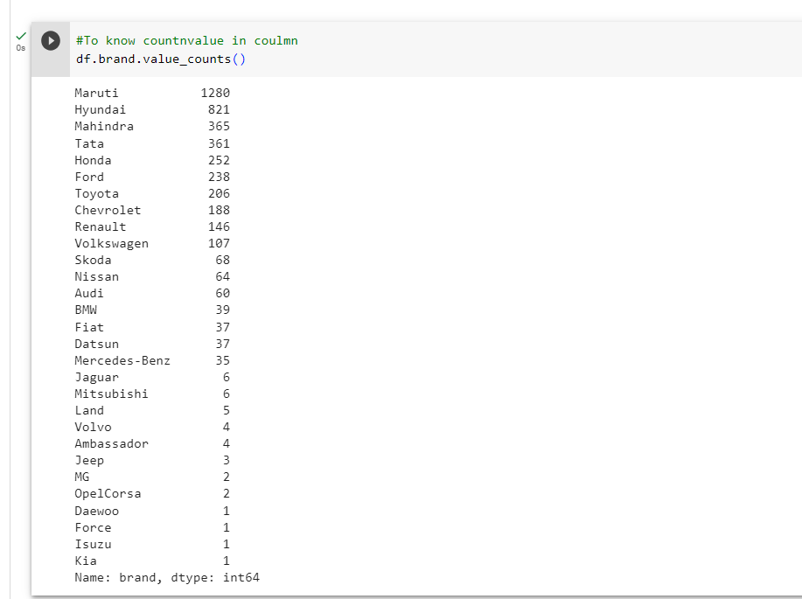
2. Importing the Dataset and Explanation of Features:
#To know countnvalue in coulmn
df.brand.value_counts()

Slide 17
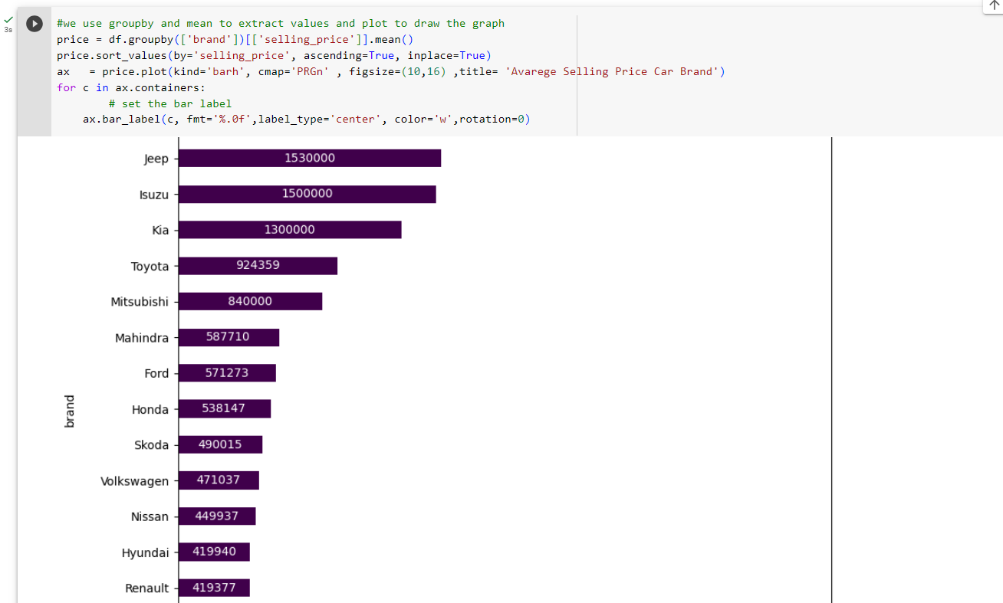
2. Importing the Dataset and Explanation of Features:
#we use groupby and mean to extract values and plot to draw the graph
price = df.groupby(['brand'])[['selling_price']].mean()
price.sort_values(by='selling_price', ascending=True, inplace=True)
ax = price.plot(kind='barh', cmap='PRGn' , figsize=(10,16) ,title= 'Avarege Selling Price Car Brand')
for c in ax.containers:
# set the bar label
ax.bar_label(c, fmt='%.0f',label_type='center', color='w',rotation=0)

Slide 18
Now trying to find out the sales classified by brand
# We will display sales by count and value in separate graphs
#plot 1:
data = df.groupby(['brand'])['brand'].count().sort_values(ascending=False) #to extract the count
x = data.index # to extract the brand name
y = data.values # to extract the count to brand
plt.subplot(2, 1, 1)#The location of the first graph 2 1 1
#the figure has 2 row, 1 columns, and this plot is the first plot.
plt.bar(x, y, color ='blue',width = 0.4)#Fomat to plt.bar
plt.rcParams['axes.facecolor'] = '#FFFFFF'#background color
plt.xticks(rotation=90) #Make the text of the label Make the text of the label at angle 90
plt.xlabel("Name",fontsize=10,color="black")#Fomat and name to x
plt.ylabel("Sales",fontsize=10,color="black")#Fomat and name to y
plt.title("ٍSales Gount",color="black")#Fomat and name to title
plt.legend(["count"], loc ="upper right" ,facecolor='green', labelcolor='black')#Fomat and name to legend
plt.rcParams['figure.figsize'] = [10, 10]#Determine the size of the graph
plt.grid(color='grey', linestyle='-', linewidth=.1)#Fomat grid network that appears in graph background
#plt.xlim([0, 1]) #
#plt.ylim([0, 2000])#
#plt.locator_params(axis='x', nbins=20)#
plt.locator_params(axis='y', nbins=20)# to make y texts 100-200-300-- like that

Slide 19
Now trying to find out the sales classified by brand
# We will display sales by count and value in separate graphs
#plot 2:
plt.subplot(2, 1, 2)#The location of the second graph 2 1 2
#the figure has 2 row, 1 columns, and this plot is the second plot.
data = df.groupby(['brand'])['selling_price'].sum().sort_values(ascending=False)
x = data.index # to extract the brand name
y = data.values #to extract the sum to brand
plt.bar(x, y, color ='blue',width = 0.4)
plt.rcParams['axes.facecolor'] = '#FFFFFF'
plt.xticks(rotation=90)
plt.xlabel("Name",fontsize=10,color="black")
plt.ylabel("Sales",fontsize=10,color="black")
plt.title("ٍSales Values",color="black")
plt.legend(["Values"], loc ="upper right" ,facecolor='green', labelcolor='black')
plt.rcParams['figure.figsize'] = [10, 10]
plt.grid(color='grey', linestyle='-', linewidth=.1)
#plt.xlim([0, 1])
#plt.ylim([0, 2000])
#plt.locator_params(axis='x', nbins=20)
plt.locator_params(axis='y', nbins=20)
#plt.margins(x=0, y=0)
plt.yticks(ticks=plt.yticks()[0], labels=plt.yticks()[0])# Show real values,numbers big without it appear short
plt.subplots_adjust(left=0.1, bottom=0.1, right=0.9,top=0.9,wspace=0.5, hspace=0.6)# set the spacing between subplots
plt.suptitle("Sales")#Name for the whole graph
plt.show()#view

Slide 20
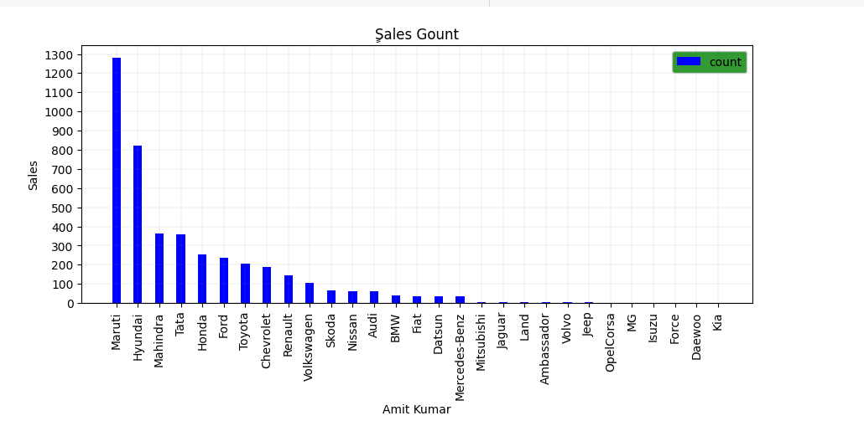
Now trying to find out the sales classified by brand

Slide 21
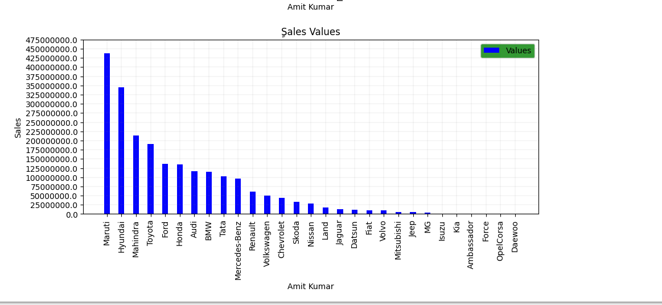
Now trying to find out the sales classified by brand

Slide 22
We will try another graph to display sales
## We will display sales by count in pie graphs
labels = df["brand"][:20].value_counts().index #We chose only twenty
sizes = df["brand"][:20].value_counts() # We chose only twenty
data = df.groupby(['brand'])['brand'].count().sort_values(ascending=False)#to extract the count
x = data.index #to extract the brand name
y = data.values#to extract the count to brand
colors = ['#F8EEFB','#66b3ff','#8000FF','#ffcc99',"#00FF1B","#FF8040","#F8AEF8"]#color choice
plt.figure(figsize = (8,8))#Determine the size of the graph
# Creating explode data
#explode = (0.1, 0.0, 0.2, 0.3, 0.0, 0.0)
plt.pie(sizes, labels=labels, rotatelabels=False, autopct='%1.1f%%',colors=colors,shadow=True, startangle=45)#Fomat pie
plt.title('name',color = 'black',fontsize = 15)#Fomat title
#plt.legend()#
plt.legend(title = "Cars")#title legend
#plt.legend(wedges, cars, title ="Cars",loc ="center left",bbox_to_anchor =(1, 0, 0.5, 1))
#myexplode = [0.2, 0, 0, 0]
plt.show()#view

Slide 23
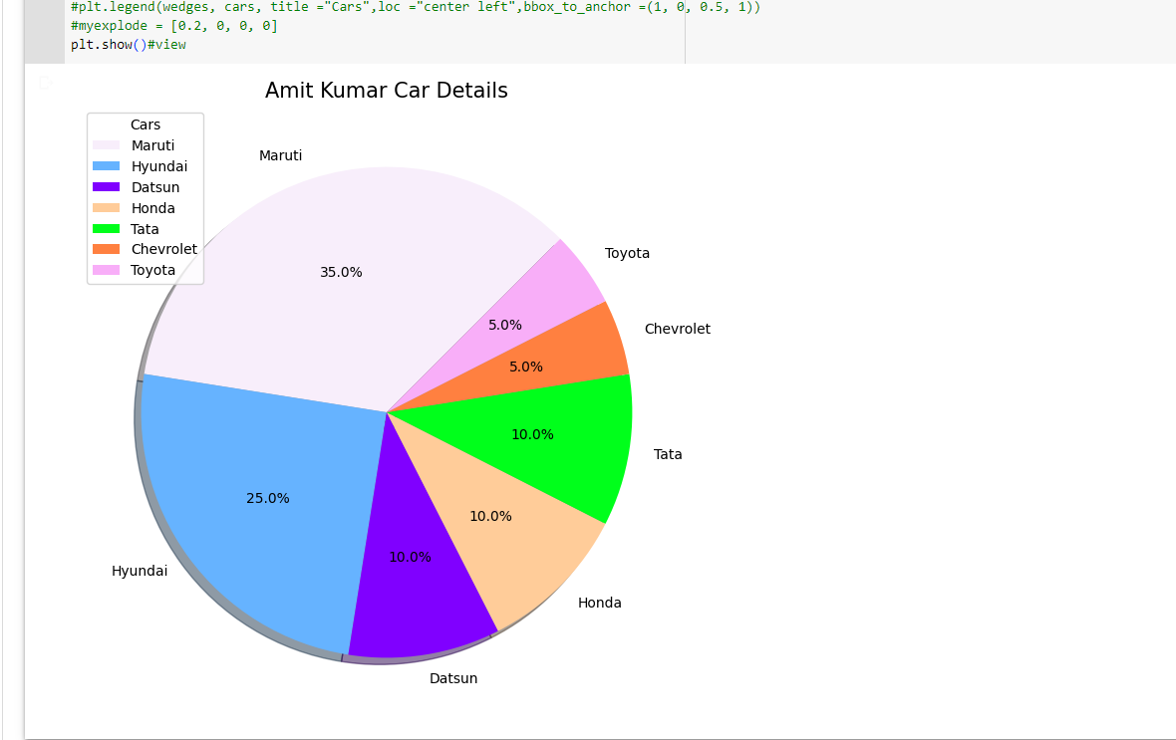
We will try another graph to display sales

Slide 24
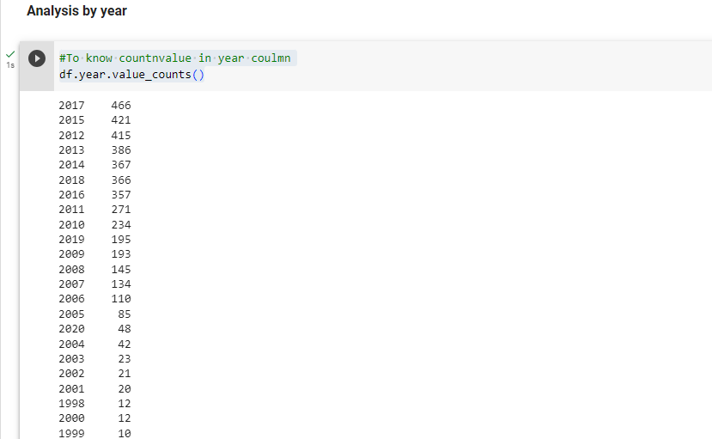
Analysis by year
#To know countnvalue in year coulmn
df.year.value_counts()

Slide 25
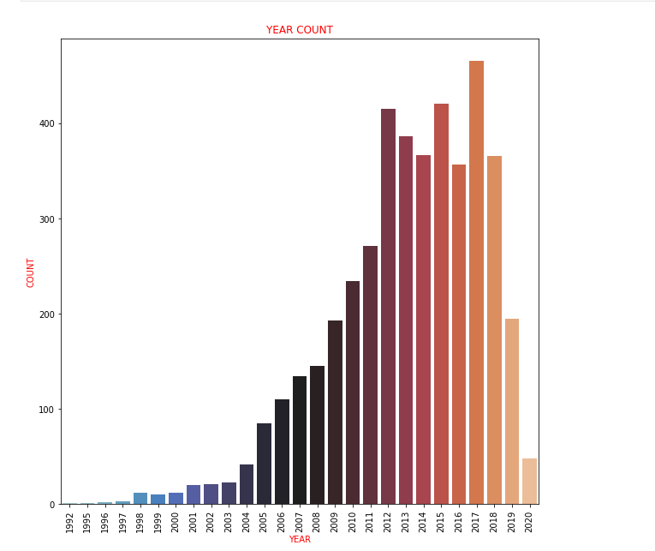
Analysis by year
#Here I am using another way to display the graph by seaborn we imported it in the beginning
sns.countplot(data=df,x="year",palette="icefire")
plt.xticks(rotation=90)
plt.xlabel("YEAR",fontsize=10,color="RED")
plt.ylabel("COUNT",fontsize=10,color="RED")
plt.title("YEAR COUNT",color="RED")
plt.show()

Slide 26
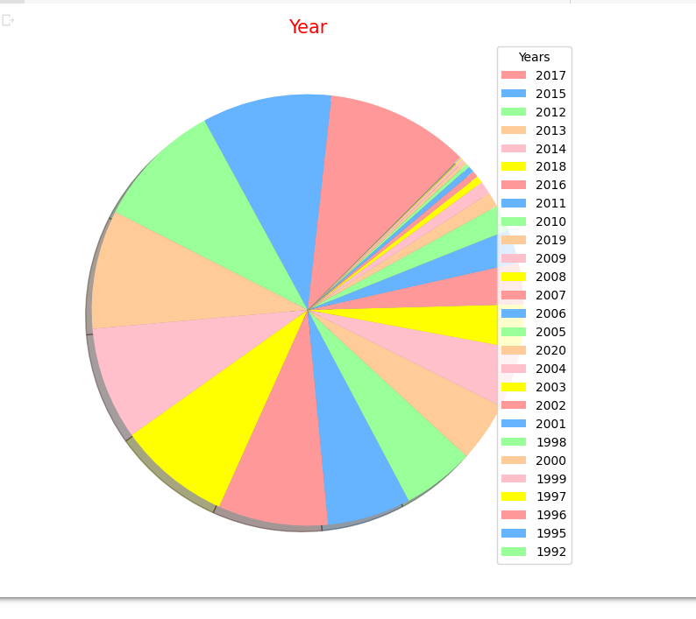
Just by looking at the graph we know which year sales in it the highest, and see the variance between sales over the years
#We will display pie graphs
labels = df["year"].value_counts().index
sizes = df["year"].value_counts()
colors = ['#ff9999','#66b3ff','#99ff99','#ffcc99',"pink","yellow"]
plt.figure(figsize = (8,8))
plt.pie(sizes, labels=labels , rotatelabels=False, autopct=None,colors=colors,shadow=True, startangle=45, labeldistance=None)
plt.title('Year',color = 'red',fontsize = 15)
plt.legend(title = "Years", loc='upper right')#title legend
plt.show()

Slide 27
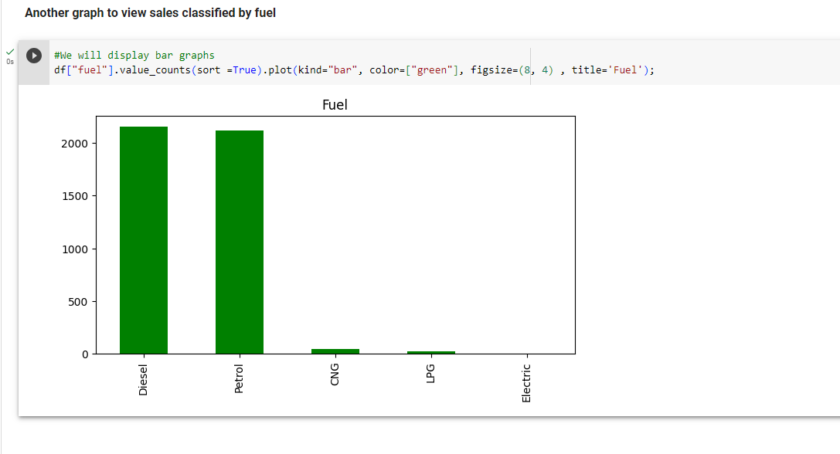
Another graph to view sales classified by fuel
#We will display bar graphs
df["fuel"].value_counts(sort =True).plot(kind="bar", color=["green"], figsize=(8, 4) , title='Fuel');

Slide 28
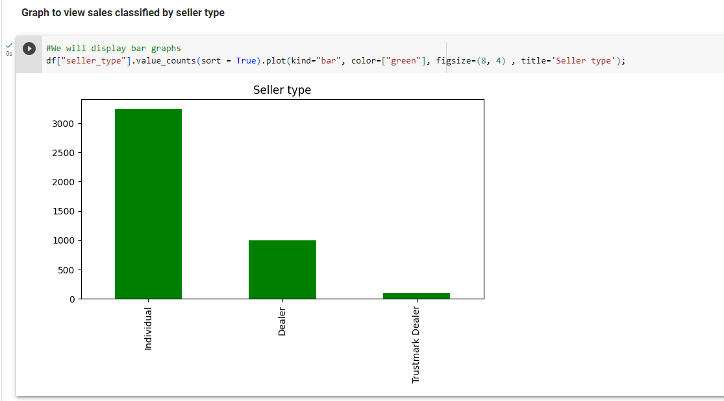
Graph to view sales classified by seller type
#We will display bar graphs
df["seller_type"].value_counts(sort = True).plot(kind="bar", color=["green"], figsize=(8, 4) , title='Seller type');

Slide 29
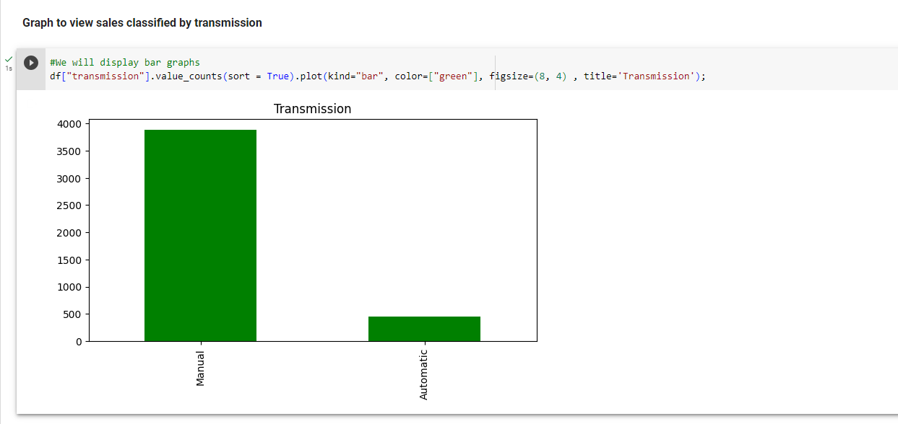
Graph to view sales classified by transmission
#We will display bar graphs
df["transmission"].value_counts(sort = True).plot(kind="bar", color=["green"], figsize=(8, 4) , title='Transmission');

Slide 30
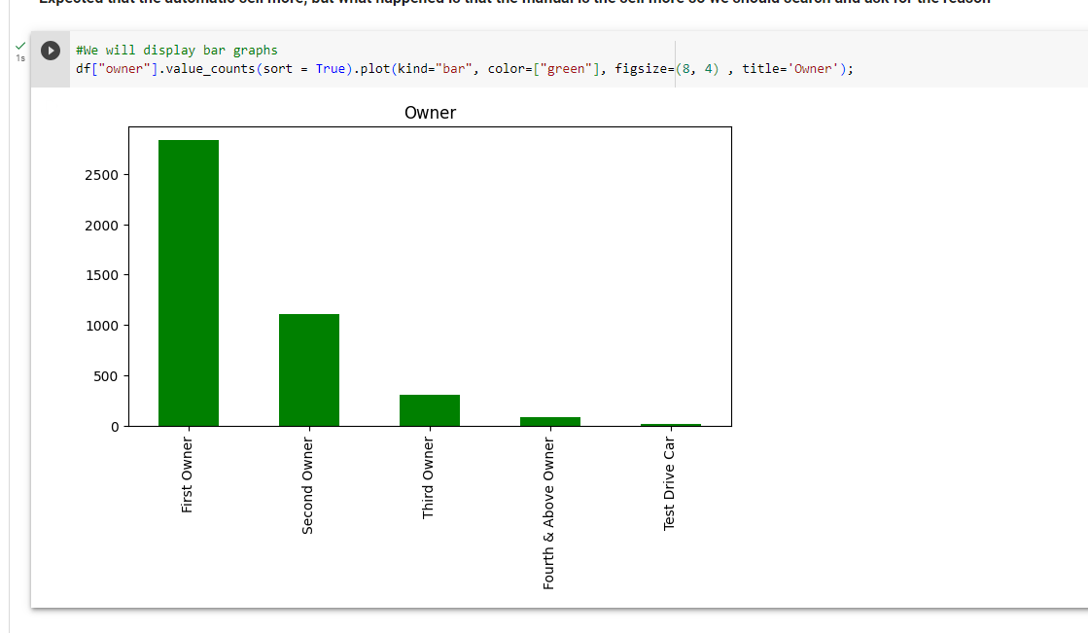
Expected that the automatic sell more, but what happened is that the manual is the sell more so we should search and ask for the reason
#We will display bar graphs
df["owner"].value_counts(sort = True).plot(kind="bar", color=["green"], figsize=(8, 4) , title='Owner');

Slide 31
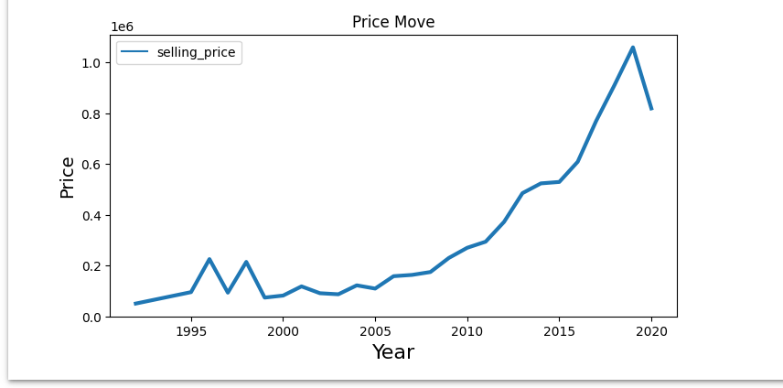
Let's draw a graph linking the year to the selling price
#We will display bar graphs line
def line_plot(data, title ,xlabel, ylabel):
plt.figure(figsize=(8, 4))
sns.lineplot(data=data , palette="tab10", linewidth=3.0)
plt.title(title, fontsize=12)
plt.ylabel(ylabel, size=14)
plt.xlabel(xlabel, size=16)
df_price_move = df.groupby(['year'])[['selling_price']].mean()
line_plot(df_price_move,'Price Move', 'Year', "Price")

Slide 32
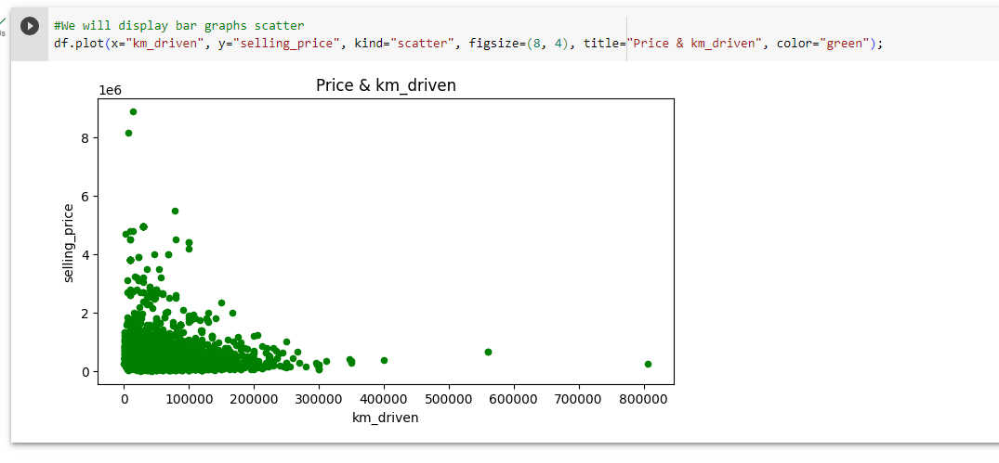
The relationship between km_driven and price
#We will display bar graphs scatter
df.plot(x="km_driven", y="selling_price", kind="scatter", figsize=(8, 4), title="Price & km_driven", color="green");

Slide 33
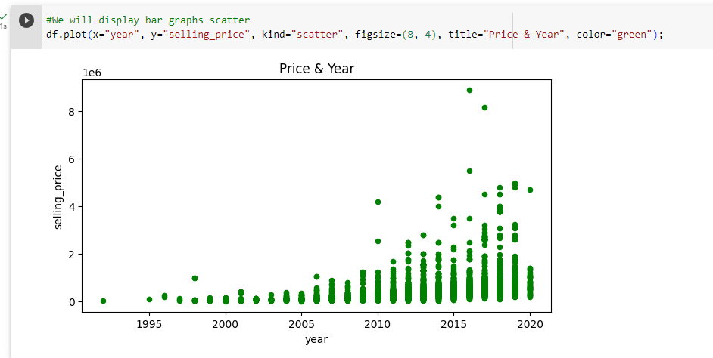
The relationship between km_driven and year
#We will display bar graphs scatter
df.plot(x="year", y="selling_price", kind="scatter", figsize=(8, 4), title="Price & Year", color="green");

Slide 34
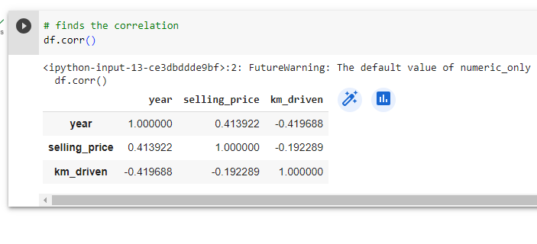
Now examine the correlation between the different factors
# finds the correlation
df.corr()

Slide 35
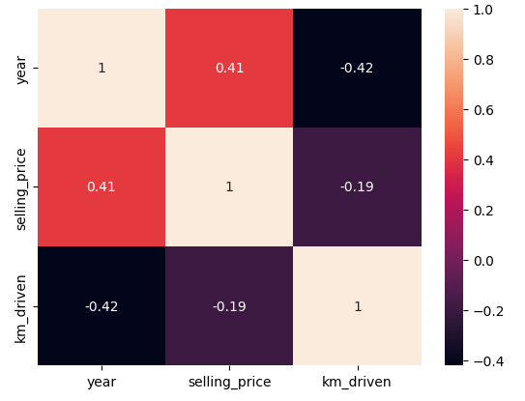
We will display heatmap
#We will display heatmap
corr = df.corr()
corr = corr['selling_price']
corr = corr.sort_values(ascending=False)
sns.heatmap(df.corr(), annot=True)
plt.show()

Slide 36
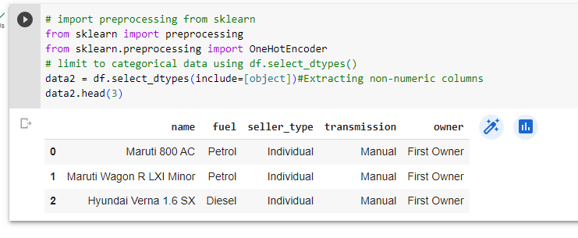
Extracting non-numeric columns
# import preprocessing from sklearn
from sklearn import preprocessing
from sklearn.preprocessing import OneHotEncoder
# limit to categorical data using df.select_dtypes()
data2 = df.select_dtypes(include=[object])#Extracting non-numeric columns
data2.head(3)

Slide 37
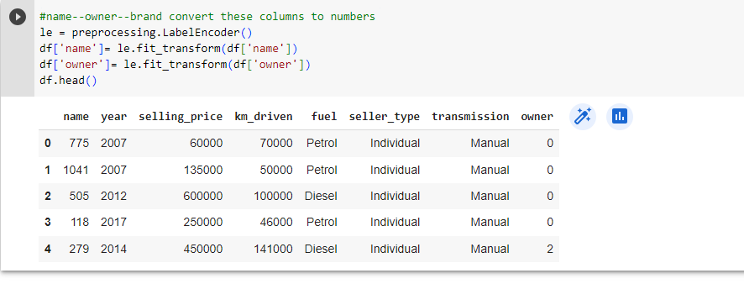
We will convert these columns to numbers (name--owner) something like that {"First Owner" : 1, "Second Owner" : 2, "Third Owner" : 3, "Fourth & Above Owner" : 4, "Test Drive Car" : 0}
#name--owner--brand convert these columns to numbers
le = preprocessing.LabelEncoder()
df['name']= le.fit_transform(df['name'])
df['owner']= le.fit_transform(df['owner'])
df.head()

Slide 38
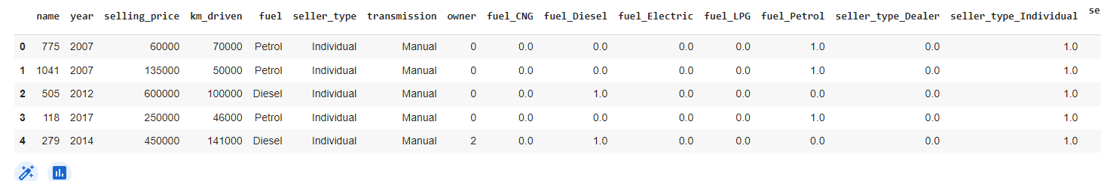
By use OneHotEncoder convert these columns (fuel, seller_type, transmission) to numbers and divide them separately and made new columns from it to be more clear, wait for the final result
#convert these columns (fuel, seller_type, transmission)
enc = OneHotEncoder(sparse = False)
X4 = df[["fuel", "seller_type", "transmission"]]
X5 = enc.fit_transform(X4)
new_col = enc.get_feature_names_out(["fuel","seller_type","transmission"])
df[new_col] = X5
df.head()

Slide 39
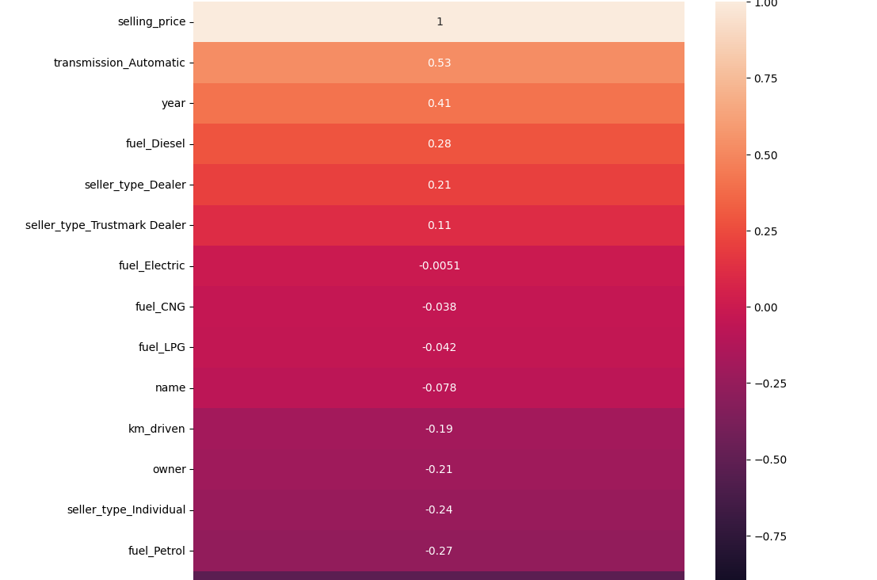
Note the new columns and the way they are created now I can create heat map that includes all factors
#new heatmap
fig, ax = plt.subplots(figsize = (10,10))
sns.heatmap(df.corr()[["selling_price"]].sort_values("selling_price", ascending = False),vmin = -1, vmax = +1, annot = True, ax = ax)
plt.show()

Slide 40
📄 Report
I will make things brief. Through our journey in analyzing the data, we found that
1.Best selling brand is Maruti then Hyundai
2.Manuals sell more than automatics
3.The newer the car the better it sells
4.Individual sell more
5.Petrol and Diesel sell more
6.Most sales were made in 2017
There are factors that affect on car price
1.The year, the newer the year, the higher the price
2.The KM Driving when increase price of car decreased
3.Brand and model of the car

Slide 41
Conclusion
All the Models performed well but the high score is of Random Forest Regressor.BY using Random Forest Regressor we can imporve Selling_Price prediction more accurately.
Thank you!!!
Amit Kumar

